Slide 1
Credit Card Fraud Detection
Capstone Project by Shravani Karra

Slide 2
Project Pipeline
01
Business Understanding
Background
Root cause analysis
5 Why + How analysis
02
Data Understanding and EDA
Load
Check for skewness
Exploratory Data Analysis
04
Model Evaluation
Evaluate the performance of the models using appropriate evaluation metrics
05
Business Impact
Demonstrate model potential benefits by performing a cost-benefit analysis

Slide 3
Business Understanding

Slide 4
Business Understanding
Finex is a leading financial service provider based out of Florida, US. It offers a wide range of products and business services to customers through different channels, ranging from in-person banking and ATMs to online banking. Many customers have been complaining about unauthorised transactions being made through their credit/debit cards. Over the last few years, Finex has observed that a significantly large number of unauthorised transactions are being made, due to which the bank has been facing a huge revenue and profitability crisis.
It has been reported that fraudsters use stolen/lost cards and hack private systems to access the personal and sensitive data of many cardholders. They also indulge in ATM skimming at various POS terminals such as gas stations, shopping malls, and ATMs that do not send alerts or do not have OTP systems through banks.
Such fraudulent activities have been reported to happen during non-peak and odd hours of the day leaving no room for suspicion.
In most cases, customers get to know of such unauthorised transactions happening through their cards quite late as they are unaware of such ongoing credit card frauds or they do not monitor their bank account activities closely. This has led to late complaint registration with Finex and by the time the case is flagged fraudulent, the bank incurs heavy losses and ends up paying the lost amount to the cardholders.
Now, Finex is also not really equipped with the latest financial technologies, and it is becoming difficult for the bank to track these data breaches on time to prevent further losses. The Branch Manager is worried about the ongoing situation and wants to identify the possible root causes and action areas to come up with a long-term solution that would help the bank generate high revenue with minimal losses.

Slide 5
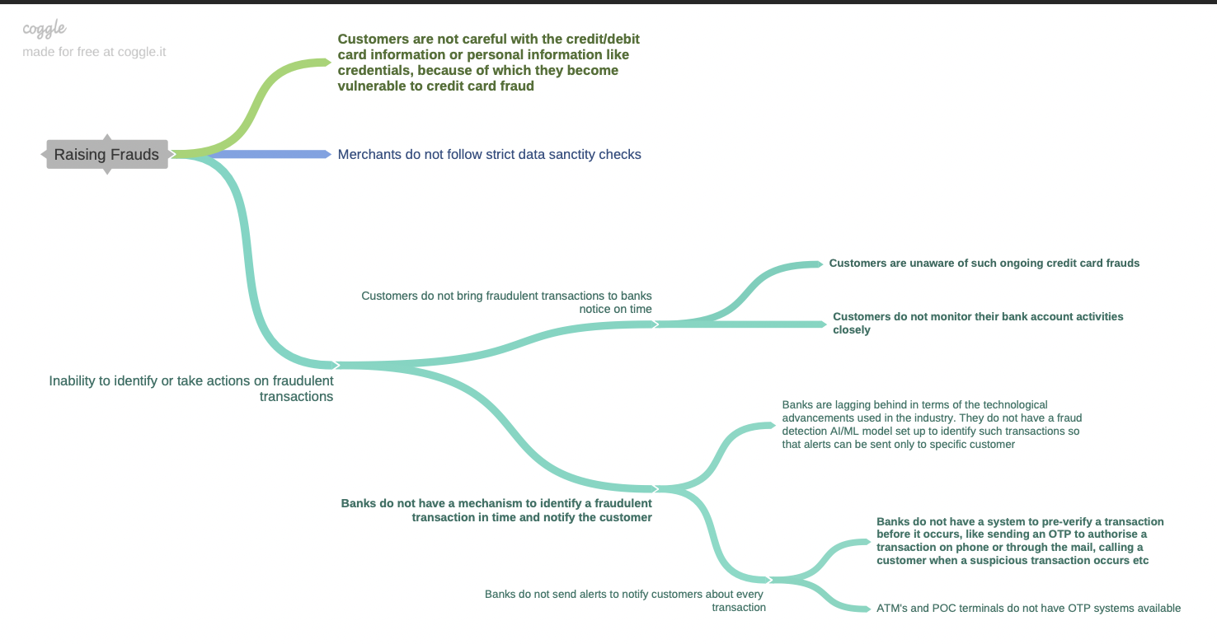
Root Cause Analysis

Slide 6
5 Ws + How Analysis
Understanding the Problem and Impact (5Ws+HOW)
Who is involved in the process?
Finex is a leading financial service provider based out of Florida, US.
What do they do with it?
Finex offers a wide range of products and business services to customers through different channels, ranging from in-person banking and ATMs to online banking. Many customers have been complaining about unauthorised transactions being made through their credit/debit cards.
Where do the transactions happen?
Fraudulent transactions happen through ATM skimming at various POS terminals such as gas stations, shopping malls, and ATMs that do not send alerts or do not have OTP systems through banks.
When does it happen?
Fraudulent activities have been reported to happen during non-peak and odd hours of the day leaving no room for suspicion
How is business affected by this?
The bank incurs heavy losses and ends up paying the lost amount to the cardholder's the a credit card fraud is not detected and stopped in time.

Slide 7
Data Understanding

Slide 8
Distribution of the Dependent Variable
Distribution of the dependent variable: is_fraud is a flag that determines if a transaction is fraudulent. The distribution of this variable is highly imbalanced, hence there is a need to balance this dataset.
Balancing the data using Over Sampling:
is_fraud | count | percentage
0 | 1842743 | 99.478999
1 | 9651 | 0.521001
is_fraud | count
0 | 1842831
1 | 1842831

Slide 9
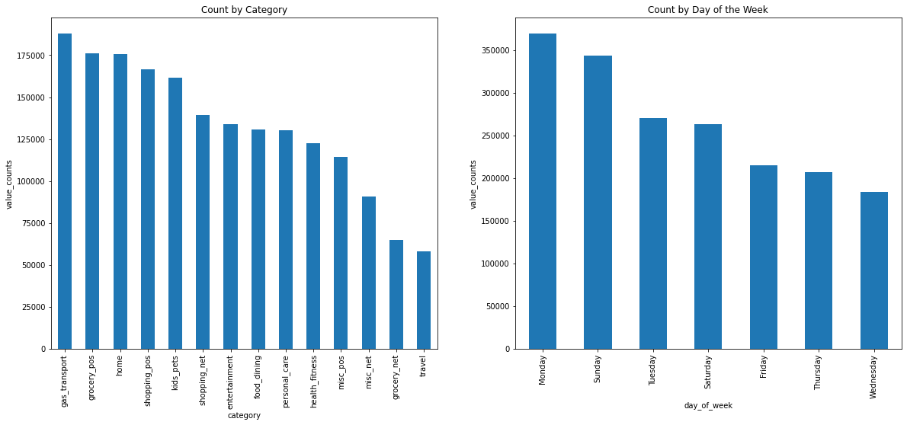
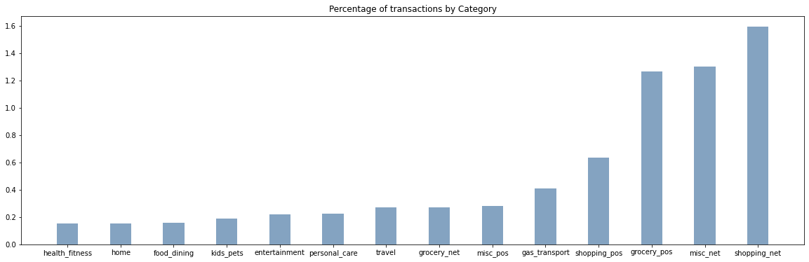
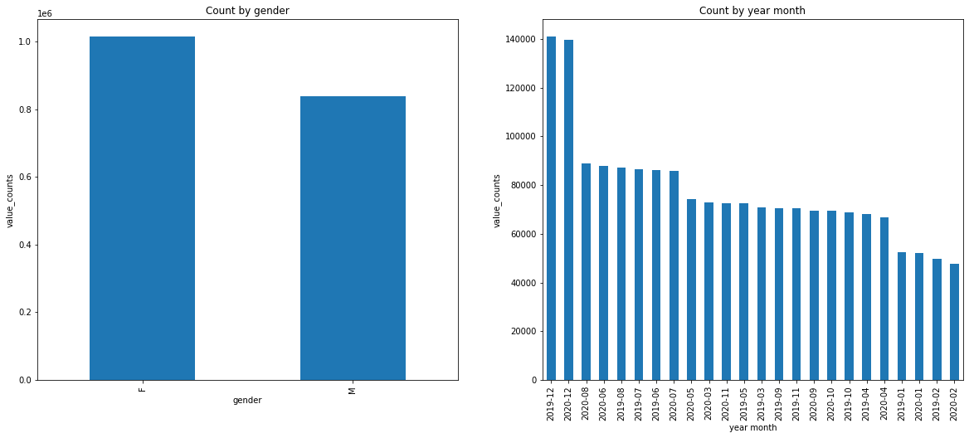
Understanding the distribution of data - By number of transactions
By pivoting the number of transactions through different dimensions, we gather some valuable insights, such as:
Mondays and Sundays have significantly higher transactions
December and Jan are the months with highest transaction count
Women seem to account for higher number of transactions
Shopping_Net category accounts for the highest percentage of transactions
The age group 22 - 57 account to 50% of the customers
Gas transport accounts to 10% of the transactions

Slide 10
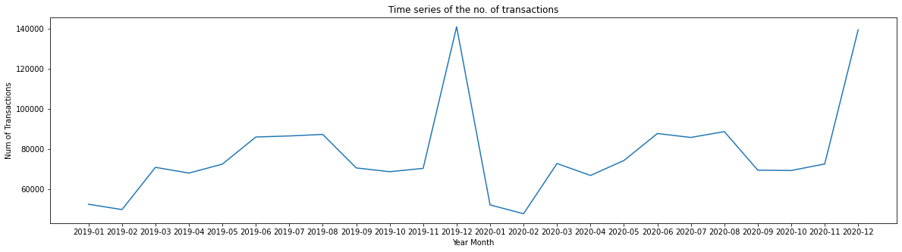
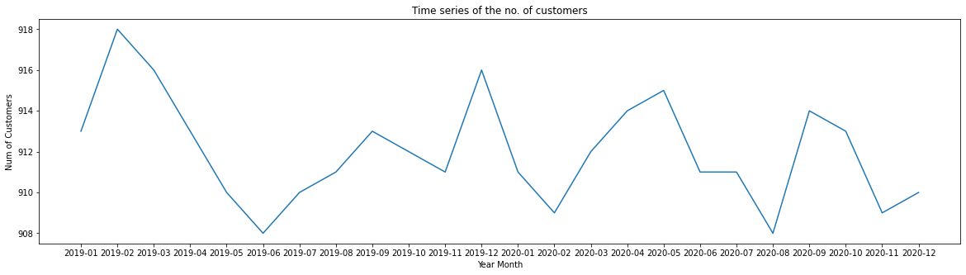
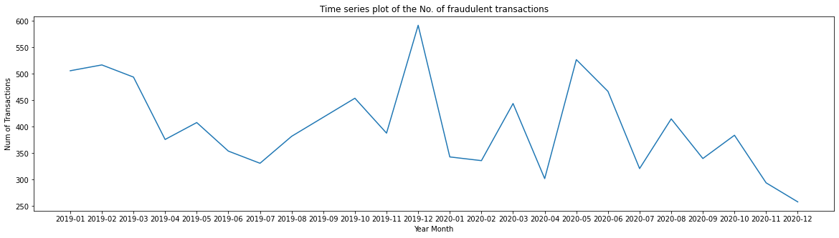
Time Series Plots to understand the seasonal cycles
Here are some time series graphs to understand the seasonal variations. We can conclude that the number of customers, transactions and intern fraudulent transactions peak during December and January

Slide 11
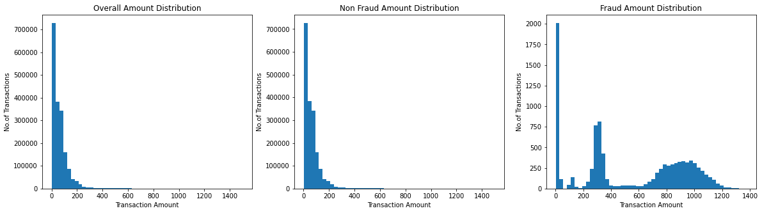
Transaction Amount Distribution
Average value of the Fraudulent transactions is way higher than non-fraudulent transactions
Mean of Non Fraud Transactions: 67.6
Mean of Fraud Transactions: 530.6

Slide 12
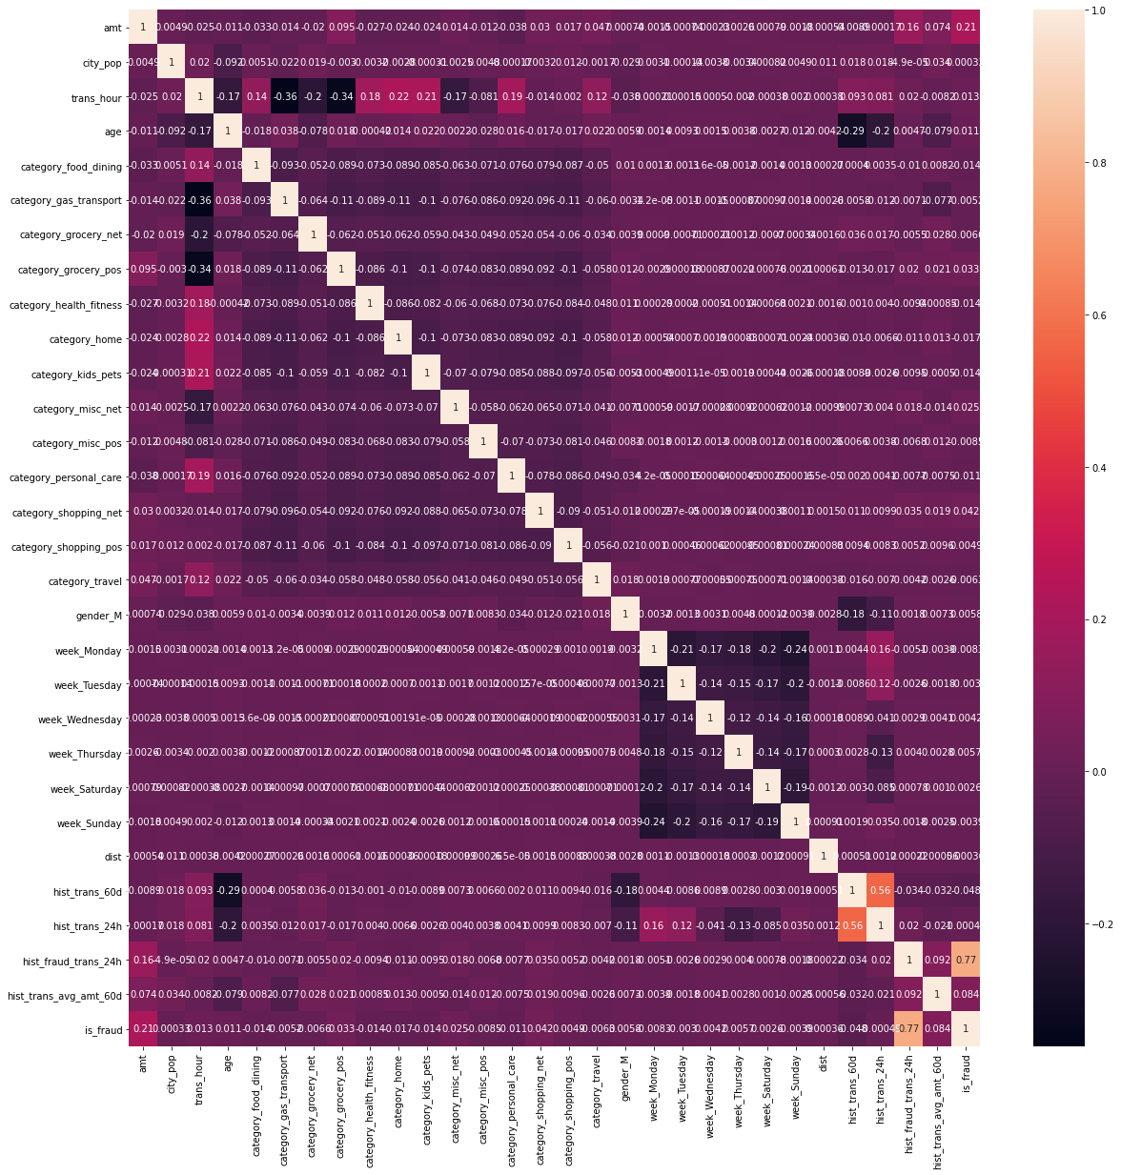
Finding correlations in data
hist_fraud_trans_24h is highly correlated with is_fraud - 0.77
hist_trans_24h is also correlated with hist_trans_60d - 0.56

Slide 13
Model Building

Slide 14
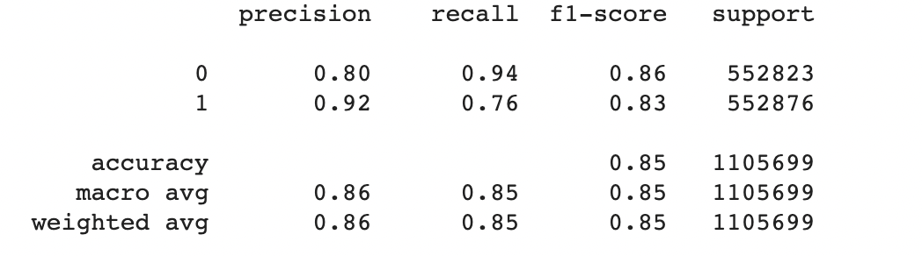
Logistic Regression Model Evaluation (Test Results)
Confusion Matrix:
[[518751 34072]
[133635 419241]]
Logistic Regression model results:
Training data:
Accuracy - 84%
recall - 76%
Testing data:
Accuracy - 84%
recall - 76%

Slide 15
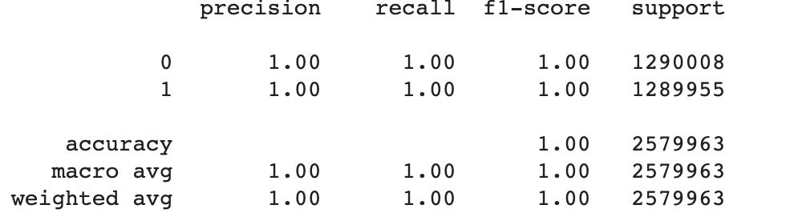
Decision Tree Model Evaluation (Test Results)
Confusion Matrix:
[[552229 594]
[ 0 552876]]
Decision Tree model results:
Training data:
Accuracy - 100%
recall - 100%
Testing data:
Accuracy - 100%
recall - 100%

Slide 16
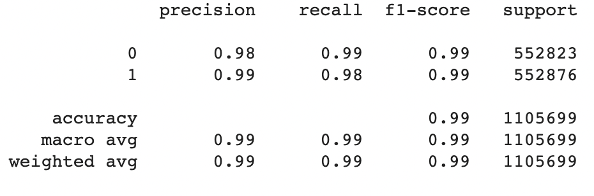
XGBoost model (test results)
Confusion Matrix:
[[549339 3484]
[ 12255 540621]]
XGBoost model results:
Training data:
Accuracy - 99%
recall - 98%
Testing data:
Accuracy - 99%
recall - 98%

Slide 17
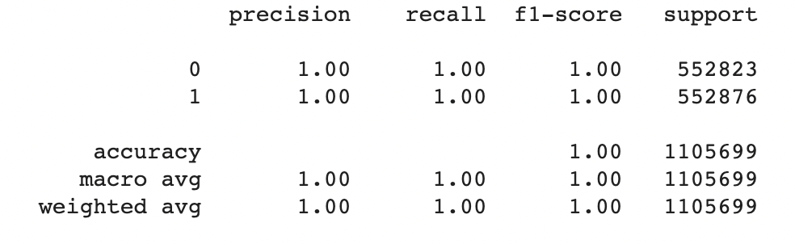
Random-Forest Classifier (Test Results)
Confusion Matrix:
[[552726 97]
[ 94 552782]]
Random Forest model results:
Training data:
Accuracy - 100%
recall - 100%
Testing data:
Accuracy - 100%
recall - 100%
In conclusion random forest classifier is the best model as it has the highest recall rate. Using this would give higher cost benefits to the company. Following cost benefit analysis uses this model.

Slide 18
Cost Benefit Analysis

Slide 19
Cost Benefit Analysis
S. No | Questions | Answer
a | Average number of transactions per month | 77183.083
b | Average number of fraudulent transaction per month | 402.125
c | Average amount per fraud transaction | 530.66
Cost Benefit Analysis
S. No | Questions | Answer
1 | Cost incurred per month before the model was deployed (b*c) | 213391.6525
2 | Average number of transactions per month detected as fraudulent by the model (TF) | 402.125
3 | Cost of providing customer executive support per fraudulent transaction detected by the model | $1.5
4 | Total cost of providing customer support per month for fraudulent transactions detected by the model (TF*$1.5) | 603.1875
5 | Average number of transactions per month that are fraudulent but not detected by the model (FN) | 0
6 | Cost incurred due to fraudulent transactions left undetected by the model (FN*c) | 0
7 | Cost incurred per month after the model is built and deployed (4+6) | 603.1875
8 | Final savings = Cost incurred before - Cost incurred after(1-7) | 212788.465
Through cost benefit analysis, we can successfully conclude that the final savings for the company would be $212,788

Slide 20
Thank you

